Slide 1
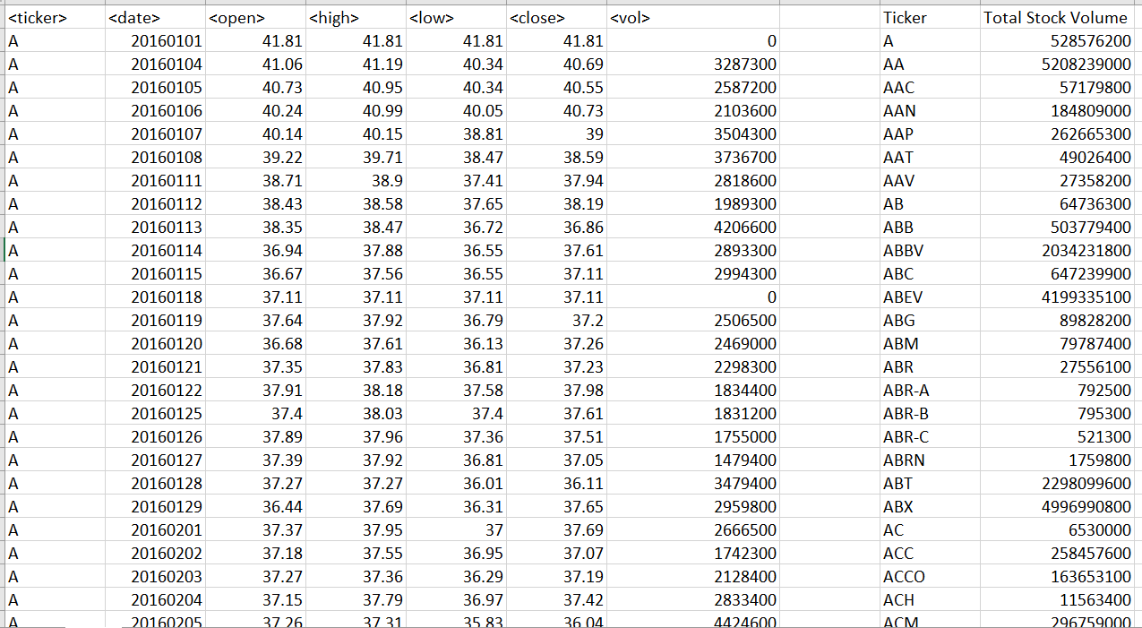
EASY HOMEWORK – YEAR 2016

Slide 2
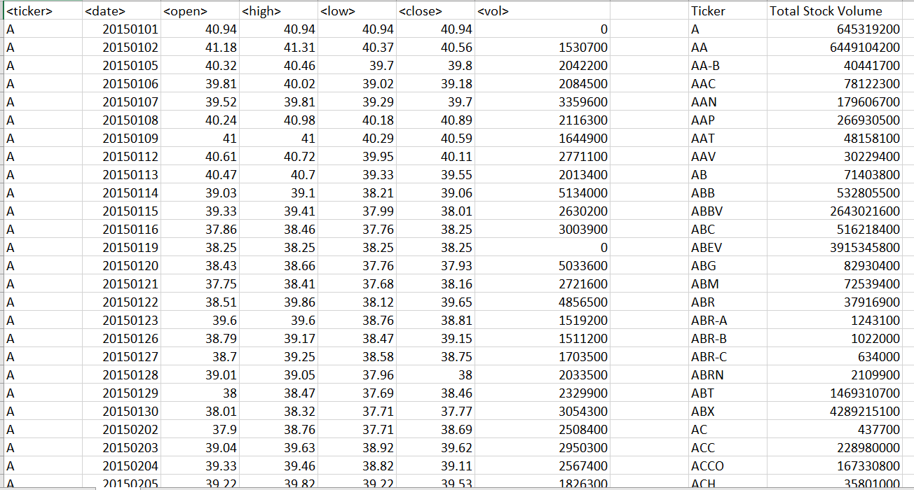
EASY HOMEWORK – YEAR 2015

Slide 3
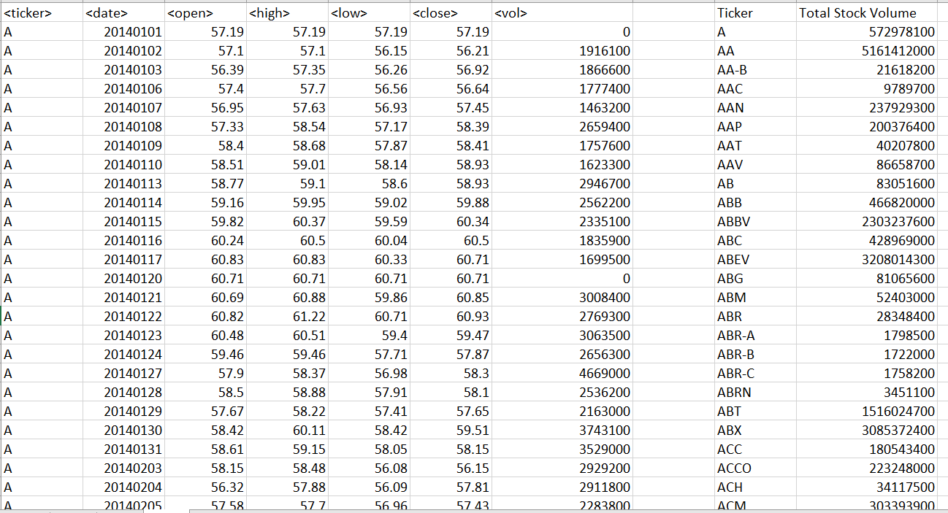
EASY HOMEWORK – YEAR 2014

